Slide 1
Chapter 10 – Contract management
SOFTWARE
PROJECT MANAGEMENT

Slide 2
Introduction
In the Brightmouth College scenario, the management of the college have made a decision to obtain their software from an external supplier.
At IOE, Amanda has a team of software developers available who are employees of IOE.
In-house developers could have periods of intense pressure interspersed by periods of relative quiet.
In both cases, project managers need to establish a contract
Notes:
Topics covered
Professional software development
What is meant by software engineering.
Software engineering ethics
A brief introduction to ethical issues that affect software engineering.
Suggested student projects
A brief introduction to each suggested project that can be carried out by students for this course

Slide 3
The ISO 12207 approach to the acquisition and supply of software
The ISO 12207 standard identifies five processes relating to software:
  Acquisition
  Supply
  Operation
  Maintenance
  Development
Notes:
Topics covered
Professional software development
What is meant by software engineering.
Software engineering ethics
A brief introduction to ethical issues that affect software engineering.
Suggested student projects
A brief introduction to each suggested project that can be carried out by students for this course

Slide 4
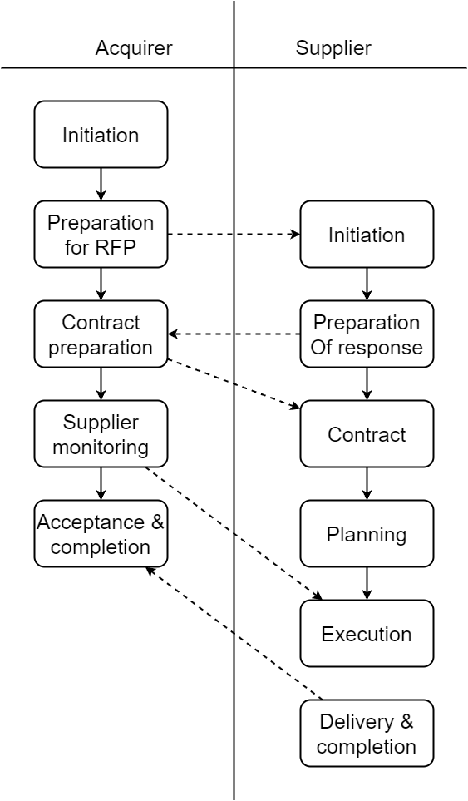
The ISO 12207 approach to the acquisition and supply of software
Notes:
Topics covered
Professional software development
What is meant by software engineering.
Software engineering ethics
A brief introduction to ethical issues that affect software engineering.
Suggested student projects
A brief introduction to each suggested project that can be carried out by students for this course

Slide 5
The acquisition process
Main steps
  Initiation
  Request for proposal
  Contract preparation and update
  Monitor supplier
  Accept completed contract
5
Notes:
Topics covered
Professional software development
What is meant by software engineering.
Software engineering ethics
A brief introduction to ethical issues that affect software engineering.
Suggested student projects
A brief introduction to each suggested project that can be carried out by students for this course

Slide 6
The supply process
This process mirrors the acquisition process, but documents the activities that a supplier would need to undertake in response to the request of supplier.
Main steps:
  Initiation
  Preparation of a response
  Contract
  Planning
  Execution and control
  Review and evaluation
  Delivery and completion
Notes:
Topics covered
Professional software development
What is meant by software engineering.
Software engineering ethics
A brief introduction to ethical issues that affect software engineering.
Suggested student projects
A brief introduction to each suggested project that can be carried out by students for this course

Slide 7
Types of contracts
The external resource required could be in the form of services.
A simple example of this could be using temporary staff on short-term contracts to carry out some project tasks.
A use of external services would be for the contractor not only to supply to supply the new system but to also operate it on the customer’s behalf.
On the other hand, the contract could be placed for the supply of a completed software package.
Notes:
Topics covered
Professional software development
What is meant by software engineering.
Software engineering ethics
A brief introduction to ethical issues that affect software engineering.
Suggested student projects
A brief introduction to each suggested project that can be carried out by students for this course

Slide 8
Acquiring software from external supplier
This could be:
a bespoke system - created specially for the customer
off-the-shelf - bought ‘as is’
customized off-the-shelf (COTS) - a core system is customized to meet needs of a particular customer
Notes:
Topics covered
Professional software development
What is meant by software engineering.
Software engineering ethics
A brief introduction to ethical issues that affect software engineering.
Suggested student projects
A brief introduction to each suggested project that can be carried out by students for this course

Slide 9
Types of contract
Fixed price contracts
Time and materials contracts
Fixed price per delivered unit
Notes:
Topics covered
Professional software development
What is meant by software engineering.
Software engineering ethics
A brief introduction to ethical issues that affect software engineering.
Suggested student projects
A brief introduction to each suggested project that can be carried out by students for this course

Slide 10
Fixed price contracts
Advantages to customer
known customer expenditure: if the requirements have been defined adequately and there are few subsequent changes, then the customer will have a known outlay.
supplier motivated to be cost-effective: the supplier has a motivation to manage the delivery of the system in a cost-effective manner.
Notes:
Topics covered
Professional software development
What is meant by software engineering.
Software engineering ethics
A brief introduction to ethical issues that affect software engineering.
Suggested student projects
A brief introduction to each suggested project that can be carried out by students for this course

Slide 11
Fixed price contracts
Disadvantages
supplier will increase price to meet contingencies: the supplier absorbs the risk for any errors in the original estimate of product size.
difficult to modify requirements: the need to change the scope of the requirements may become apparent as the system is developed.
Notes:
Topics covered
Professional software development
What is meant by software engineering.
Software engineering ethics
A brief introduction to ethical issues that affect software engineering.
Suggested student projects
A brief introduction to each suggested project that can be carried out by students for this course

Slide 12
Fixed price contracts
cost of changes likely to be higher: when competing against other potential suppliers, the supplier will try to quote as low a price as possible.
threat to system quality: the need to meet a fixed price could mean that the quality of the software suffers.
Notes:
Topics covered
Professional software development
What is meant by software engineering.
Software engineering ethics
A brief introduction to ethical issues that affect software engineering.
Suggested student projects
A brief introduction to each suggested project that can be carried out by students for this course

Slide 13
Time and materials contracts
Advantages to customer
easy to change requirements: change to requirements are dealt with easily.
lack of price pressure can assist product quality: The lack of price pressure may allow better quality software to be produced.
Notes:
Topics covered
Professional software development
What is meant by software engineering.
Software engineering ethics
A brief introduction to ethical issues that affect software engineering.
Suggested student projects
A brief introduction to each suggested project that can be carried out by students for this course

Slide 14
Time and materials contracts
Disadvantages
Customer liability: the customer absorbs all the risk associated with poorly defined or changing requirements
Lack of incentive for supplier to be cost-effective: The supplier has no incentive to work in a costeffectivesupplier has no incentive to work in a cost-effective manner or to control the scope of the system to be delivered.
Notes:
Topics covered
Professional software development
What is meant by software engineering.
Software engineering ethics
A brief introduction to ethical issues that affect software engineering.
Suggested student projects
A brief introduction to each suggested project that can be carried out by students for this course

Slide 15
Fixed price per unit delivered contracts
FP count | Design cost/FP | implement-ation cost/FP | total cost/FP
To 2,000 | $242 | $725 | $967
2,001 – 2,500 | $255 | $764 | $1,019
2,501 – 3,000 | $265 | $793 | $1,058
3,001 – 3,500 | $274 | $820 | $1,094
3,501 – 4,000 | $284 | $850 | $1,134
Notes:
Topics covered
Professional software development
What is meant by software engineering.
Software engineering ethics
A brief introduction to ethical issues that affect software engineering.
Suggested student projects
A brief introduction to each suggested project that can be carried out by students for this course

Slide 16
Fixed price per unit delivered contracts example
Estimated system size 2 600 FPs
Price
  2000 FPs x $967 plus
  500 FPs x $1,019 plus
  100 FPs x $1,058
  i.e. $2,549,300
Notes:
Topics covered
Professional software development
What is meant by software engineering.
Software engineering ethics
A brief introduction to ethical issues that affect software engineering.
Suggested student projects
A brief introduction to each suggested project that can be carried out by students for this course

Slide 17
Fixed price per unit delivered contracts
Ad vantages for customer
  Customer understanding of how price is calculated
  Comparability between different pricing schedules
  Supplier incentive to be cost-effective
Notes:
Topics covered
Professional software development
What is meant by software engineering.
Software engineering ethics
A brief introduction to ethical issues that affect software engineering.
Suggested student projects
A brief introduction to each suggested project that can be carried out by students for this course

Slide 18
Fixed price per unit delivered contracts
Disadvantages
difficulties with software size measurement - may need independent FP counter
changing (as opposed to new) requirements: how do you charge?
Notes:
Topics covered
Professional software development
What is meant by software engineering.
Software engineering ethics
A brief introduction to ethical issues that affect software engineering.
Suggested student projects
A brief introduction to each suggested project that can be carried out by students for this course

Slide 19
The tendering process
Tendering types:
  Open
  Restricted
  Negotiated
Notes:
Topics covered
Professional software development
What is meant by software engineering.
Software engineering ethics
A brief introduction to ethical issues that affect software engineering.
Suggested student projects
A brief introduction to each suggested project that can be carried out by students for this course

Slide 20
The tendering process
Open tendering
  any supplier can bid in response to the invitation to tender
  all tenders must be evaluated in the same way
  government bodies may have to do this by local/international law (including EU and WTO, World Trade Organization, requirements
Notes:
Topics covered
Professional software development
What is meant by software engineering.
Software engineering ethics
A brief introduction to ethical issues that affect software engineering.
Suggested student projects
A brief introduction to each suggested project that can be carried out by students for this course

Slide 21
The tendering process
Restricted tendering process
  bids only from those specifically invited
  can reduce suppliers being considered at any stage
Negotiated procedure
  negotiate with one supplier e.g. for extensions to software already supplied
Notes:
Topics covered
Professional software development
What is meant by software engineering.
Software engineering ethics
A brief introduction to ethical issues that affect software engineering.
Suggested student projects
A brief introduction to each suggested project that can be carried out by students for this course

Slide 22
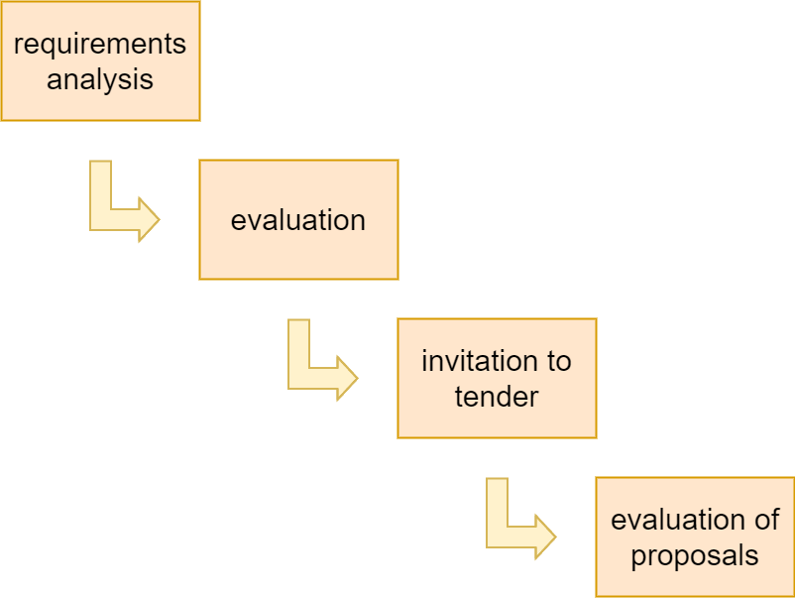
Stages in contract placement
Notes:
Topics covered
Professional software development
What is meant by software engineering.
Software engineering ethics
A brief introduction to ethical issues that affect software engineering.
Suggested student projects
A brief introduction to each suggested project that can be carried out by students for this course

Slide 23
Requirement analysis
Before potential suppliers can be approached, you need to have a clear set of requirements.
The requirements document might typically have different sections.
Notes:
Topics covered
Professional software development
What is meant by software engineering.
Software engineering ethics
A brief introduction to ethical issues that affect software engineering.
Suggested student projects
A brief introduction to each suggested project that can be carried out by students for this course

Slide 24
Requirements document: sections
Introduction
Description of existing system and current environment
Future strategy or plans
System requirements – mandatory/desirable features
Deadlines
Additional information required from bidders
Notes:
Topics covered
Professional software development
What is meant by software engineering.
Software engineering ethics
A brief introduction to ethical issues that affect software engineering.
Suggested student projects
A brief introduction to each suggested project that can be carried out by students for this course

Slide 25
Requirements
These will include
  functions in software, with necessary inputs and outputs
  standards to be adhered to
  other applications with which software is to be compatible
  quality requirements e.g. response times
Notes:
Topics covered
Professional software development
What is meant by software engineering.
Software engineering ethics
A brief introduction to ethical issues that affect software engineering.
Suggested student projects
A brief introduction to each suggested project that can be carried out by students for this course

Slide 26
Requirements
Requirements types:
  Mandatory
  Desirable
Notes:
Topics covered
Professional software development
What is meant by software engineering.
Software engineering ethics
A brief introduction to ethical issues that affect software engineering.
Suggested student projects
A brief introduction to each suggested project that can be carried out by students for this course

Slide 27
Evaluation plan
Having drawn up a list of requirements, we now need to draw up a plan of how the proposals which are submitted are to be evaluated.
Notes:
Topics covered
Professional software development
What is meant by software engineering.
Software engineering ethics
A brief introduction to ethical issues that affect software engineering.
Suggested student projects
A brief introduction to each suggested project that can be carried out by students for this course

Slide 28
Evaluation plan
Need to assess value for money (VFM) for each desirable feature
VFM approach an improvement on previous emphasis on accepting lowest bid
Example:
  feeder file saves data input
  4 hours work a month saved at £20 an hour
  system to be used for 4 years
  if cost of feature £1000 would it be worth it?
Notes:
Topics covered
Professional software development
What is meant by software engineering.
Software engineering ethics
A brief introduction to ethical issues that affect software engineering.
Suggested student projects
A brief introduction to each suggested project that can be carried out by students for this course

Slide 29
Invitation to tender (ITT)
Note that bidder is making an offer in response to ITT
Acceptance of offer creates a contract
Customer may need further information
Problem of different technical solutions to the same problem
Notes:
Topics covered
Professional software development
What is meant by software engineering.
Software engineering ethics
A brief introduction to ethical issues that affect software engineering.
Suggested student projects
A brief introduction to each suggested project that can be carried out by students for this course

Slide 30
Memoranda of agreement (MoA)
Customer asks for technical proposals
Technical proposals are examined and discussed
Agreed technical solution in MoA
Tenders are then requested from suppliers based in MoA
Tenders judged on price
Fee could be paid for technical proposals by customer
Notes:
Topics covered
Professional software development
What is meant by software engineering.
Software engineering ethics
A brief introduction to ethical issues that affect software engineering.
Suggested student projects
A brief introduction to each suggested project that can be carried out by students for this course

Slide 31
Evaluation of proposal
How are proposals to be evaluated?
Methods could include:
  Reading proposals
  Interviews
  Demonstrations
  Site visits
  Practical tests
Notes:
Topics covered
Professional software development
What is meant by software engineering.
Software engineering ethics
A brief introduction to ethical issues that affect software engineering.
Suggested student projects
A brief introduction to each suggested project that can be carried out by students for this course

Slide 32
Typical terms of a contract-Contract checklist
Definitions – what words mean precisely e.g. ‘supplier’, ‘user’, ‘application’
Form of agreement For example is this a contract for a sale or a lease, or a license to use a software application? Can the license be transferred?
Goods and services to be supplied – this could include lengthy specification
Timetable of activities
Payment arrangements – payments may be tied to completion of specific tasks
Notes:
Topics covered
Professional software development
What is meant by software engineering.
Software engineering ethics
A brief introduction to ethical issues that affect software engineering.
Suggested student projects
A brief introduction to each suggested project that can be carried out by students for this course

Slide 33
Contract checklist - continued
Ownership of software
  Can client sell software to others?
  Can supplier sell software to others? Could specify that customer has ‘exclusive use’
  Does supplier retain the copyright?
  Where supplier retains source code, may be a problem if supplier goes out of business; to circumvent a copy of code could be deposited with an escrow service
Notes:
Topics covered
Professional software development
What is meant by software engineering.
Software engineering ethics
A brief introduction to ethical issues that affect software engineering.
Suggested student projects
A brief introduction to each suggested project that can be carried out by students for this course

Slide 34
Contract checklist - continued
Environment –for example, where equipment is to be installed, who is responsible for various aspects of site preparation e.g. electricity supply?
Customer commitments – for example providing access, supplying information
Standards to be met
Project and quality management
Notes:
Topics covered
Professional software development
What is meant by software engineering.
Software engineering ethics
A brief introduction to ethical issues that affect software engineering.
Suggested student projects
A brief introduction to each suggested project that can be carried out by students for this course

Slide 35
Contract management
Some terms of contract will relate to management of contract for example,
Progress reporting
Decision points – could be linked to release of payments to the contractor
Notes:
Topics covered
Professional software development
What is meant by software engineering.
Software engineering ethics
A brief introduction to ethical issues that affect software engineering.
Suggested student projects
A brief introduction to each suggested project that can be carried out by students for this course

Slide 36
Contract management
Contracts should include agreement about how customer /supplier relationship is to be managed e.g.
  Decision points - could be linked to payment
  Quality reviews
  Changes to requirements
Variations to the contract, i.e. how are changes to requirements dealt with?
Acceptance criteria
Notes:
Topics covered
Professional software development
What is meant by software engineering.
Software engineering ethics
A brief introduction to ethical issues that affect software engineering.
Suggested student projects
A brief introduction to each suggested project that can be carried out by students for this course

Slide 37
Acceptance
When the work has been completed, the customer needs to take action to carry out acceptance testing.
Part of all the payment to supplier should depend on this acceptance testing.
Notes:
Topics covered
Professional software development
What is meant by software engineering.
Software engineering ethics
A brief introduction to ethical issues that affect software engineering.
Suggested student projects
A brief introduction to each suggested project that can be carried out by students for this course

Slide 38
Conclusion
Some of the key points in this chapter have been:
  The successful contracting out of work requires considerable amounts of management time
  Alternative proposals need to be evaluated as far as possible by comparing costs over the whole lifetime of the system rather than just the acquisition costs
Notes:
Topics covered
Professional software development
What is meant by software engineering.
Software engineering ethics
A brief introduction to ethical issues that affect software engineering.
Suggested student projects
A brief introduction to each suggested project that can be carried out by students for this course

Slide 39
Conclusion
Some of the key points in this chapter have been:
  A contract will place obligations on the customer as well as the supplier
  Contract negotiation should include reaching agreement on the management of the supplier-customer relationship during the execution of the project.
Notes:
Topics covered
Professional software development
What is meant by software engineering.
Software engineering ethics
A brief introduction to ethical issues that affect software engineering.
Suggested student projects
A brief introduction to each suggested project that can be carried out by students for this course

